Slide 1
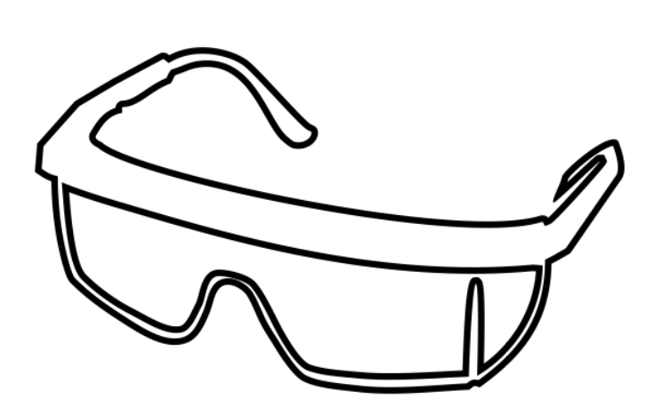
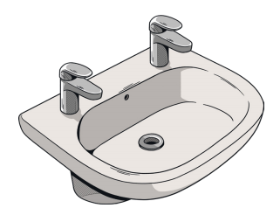
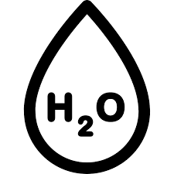
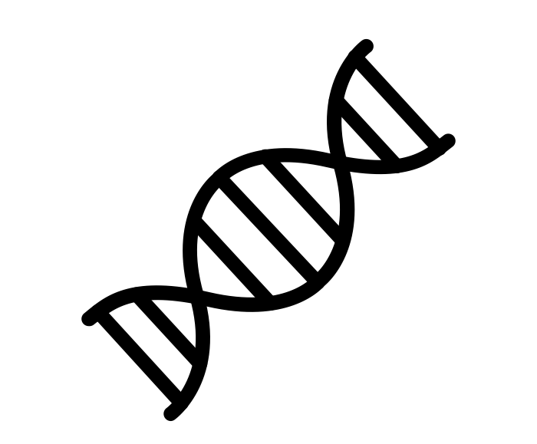
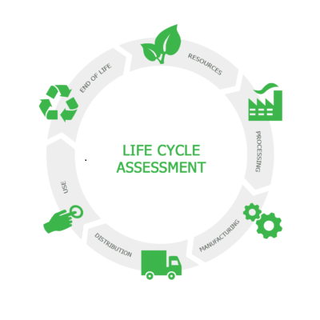
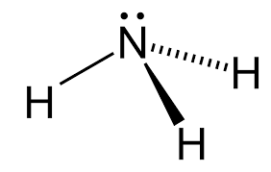
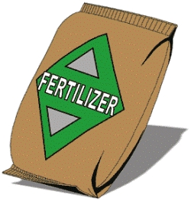
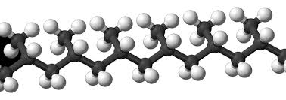
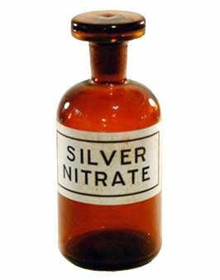
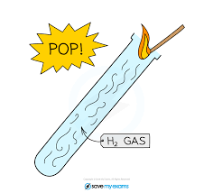
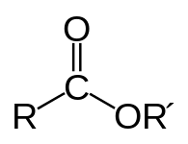
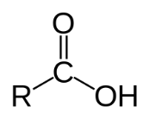
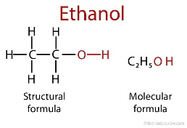
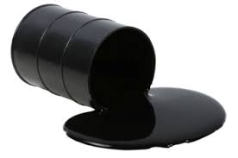
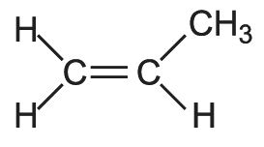
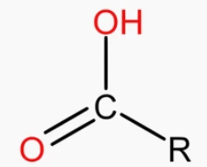
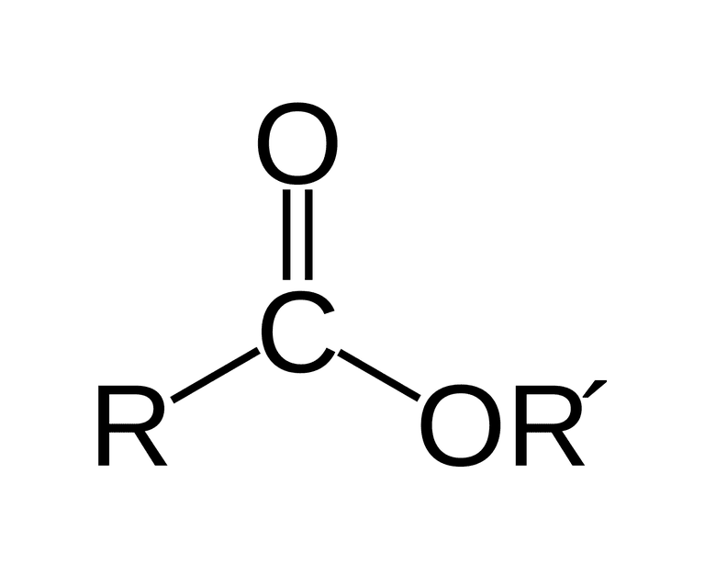
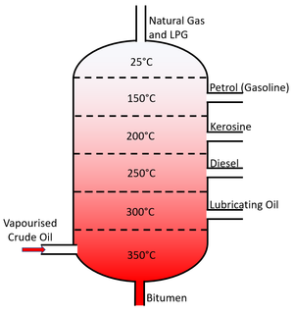
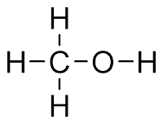
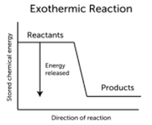
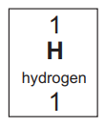
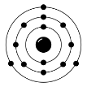
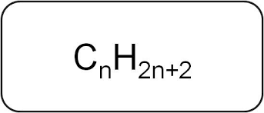
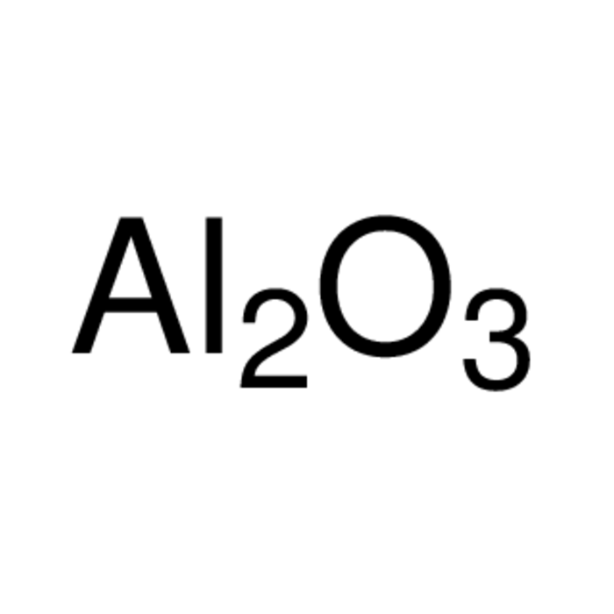
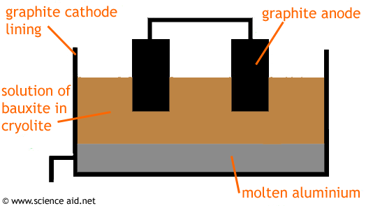
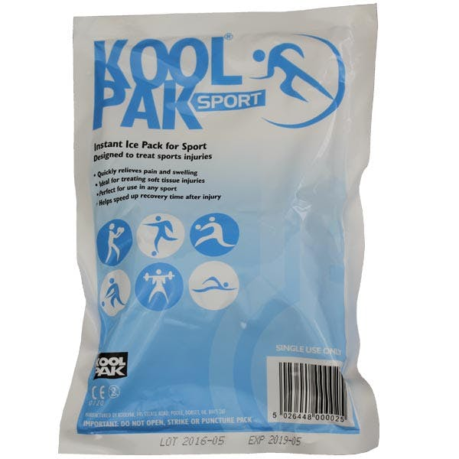
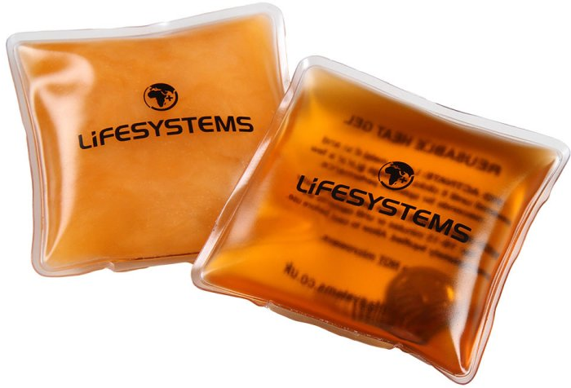
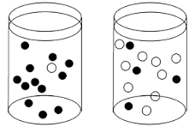
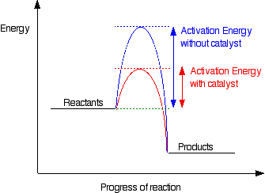
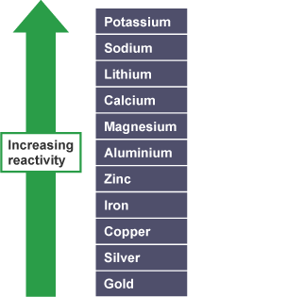
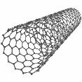
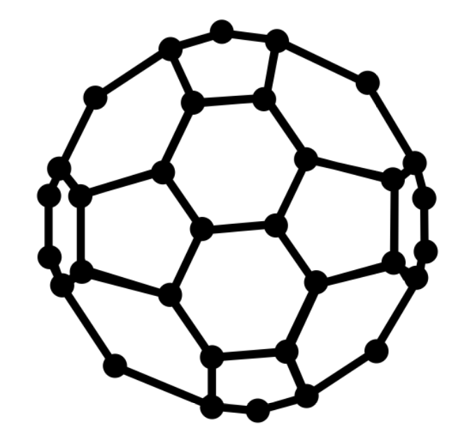
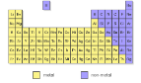
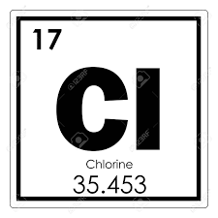
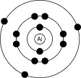
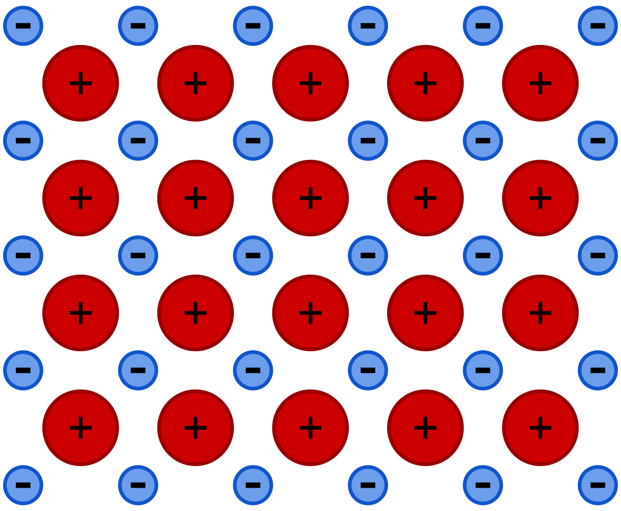
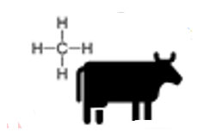
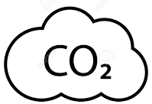
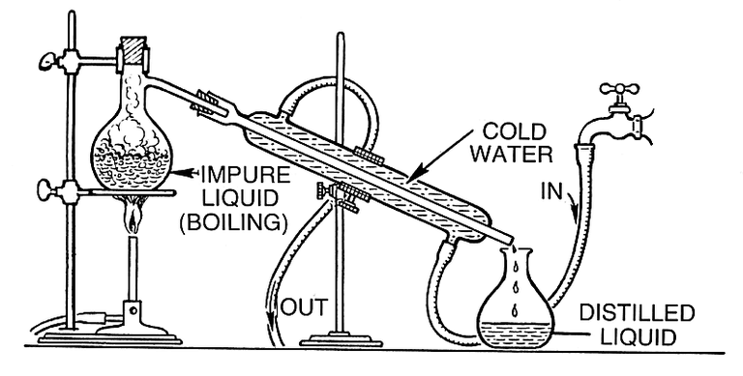
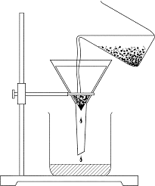
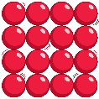
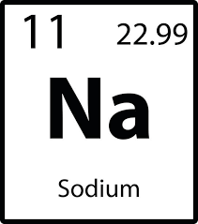
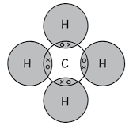
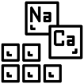
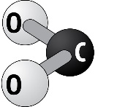
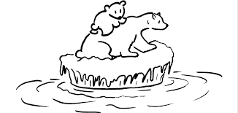
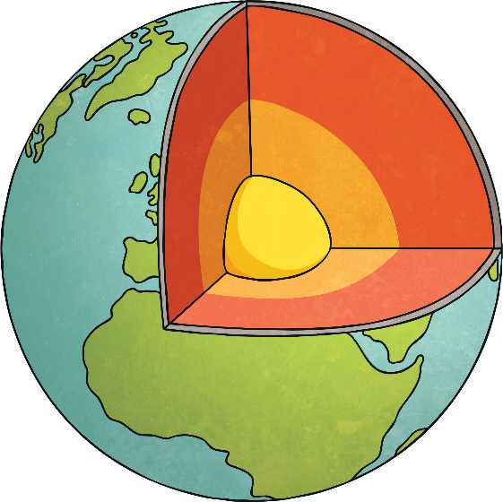
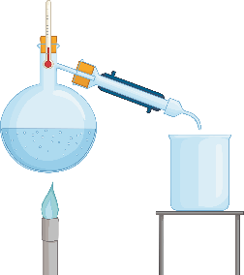
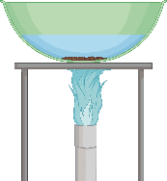
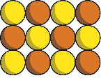
CHEMISTRY
Learning journey
St John Henry Newman Catholic School
Understanding variables
Assessing impact of scientific concepts
Drawing conclusions
Evaluation of scientific concepts
Writing
methods
Applying maths to the scientific concepts
Describe patterns
Year 7
Understanding and Applying Scientific Skills
Year 13
Drawing graphs and analysing graphical data
Analysis of secondary data
Modelling scientific concepts
Understanding relationships between science and society
IDEAL
Identify, describe, explain, apply, link
Risk Assessment
Evaluating data and investigations
Condensation polymerisation
GCSE exams
A Level Sciences – Biology, Chemistry & Physics
(Need grade 6 and grade 6 in Maths)
Useful alloys
Properties of polymers
Glass, ceramics, & composites
DNA
Applied Science A Level
Using our resources
Polymers
Organic
Chemistry
Rusting
The Haber process
Making fertilisers
Polymers
Natural polymers
Other post 16 options Apprenticeships, college, other A level subjects)
Life cycle assessment
recycling
Reduce, reuse, recycle
Treating waste water
Finite & renewable resources
Instrumental
analysis
Testing for ions
Testing for gases
Carboxylic acids
esters
Reactions and uses of alcohol
Using the Earth’s resources
Chemical analysis
Reactions of alkenes & alcohol
C₃₀H₆₂
Extracting metals from ores
Obtaining potable water
Water safe to drink
Analysing chromatograms
Pure substance & mixtures
Reactions of alkenes
Cracking hydrocarbons
Structure alcohols,
carboxylic acids,
& esters
Crude oil & fuels
Burning fuels
Fractional distillation
2H⁺ + 2e⁻ → H₂
Chemical cells & batteries
The effect of temperature
Hydrocarbons
Electrolysis of molten compounds
Changes at the electrodes
Electrolysis of solutions
Exothermic & endothermic
Reaction profiles
Fuel cells
Moles
Limiting reagents
Atom economy
Titrations
Rates of reactions
Dynamic equilibrium
Electrolysis
Energy changes
Quantitative chemistry
Rate & extent of chemical change
Reversible reactions
Extraction of Aluminium
Uses of energy transfers
Bond energy calculations
Relative mass
Reacting Mass
Yield
Concentration
Collision theory
Effect of concentration & pressure
Catalysts
dm³
2:1
Greenhouse
gases
Changing Atmosphere
Metal extraction
Giant covalent structures
Transition metals
Electronic structure
Ionic
bonding
H⁺
Reactions of acids
Reactivity series
Nanoparticles
Group 7
Halogens
Metallic
bonding
Fractional distillation
Strong & weak acids
Chemical changes
Bonding properties
Periodic table
Types of bonding
The Earth’s atmosphere
Atomic number and isotopes
Indicators & pH
Neutralisation
Making salts
Metal conductivity
States of matter
Group 1
Alkali Metals
Group 0
Nobel Gases
Covalent
bonding
Climate
change
History
Atmosphere
Atoms, bonding & moles
Separating mixtures
History of the atom
Chemical equations
Elements
Atoms
Compounds
The Periodic
table
Group 7
Halogens
Atoms in chemical reactions
Thermal decomposition
Endothermic exothermic reactions
Energy Level
Diagrams
Global warming
The Carbon Cycle
KS4
Atoms
Electronic structure
Elements
Periodic table
Types of reaction
Chemical Energy
Climate
Earth
resources
Polymers
Chemical formulae
Group 1
Alkali Metals
Group 0
Nobel Gases
Combustion
Conservation of mass
Bond energies
Climate
change
Extracting metals
Recycling
The Earth
Ceramics
Structure of the Earth
Metal displacement reactions
Metals & non-metals
Neutralisation
Chemical Reactions
Evaporation & distillation
Filtration
Inside particles
Diffusion
Melting freezing
Boiling
The Rock Cycle
Earth’s structure
Making salts
Separating mixtures
Particle model
KS3
Metamorphic rocks
Metals &
non-metals
Acids & Alkalis
Metals & acids, oxygen, water
Acid
strength
Acids
& Alkalis
Chromatography
Solutions
solubility
Pure substances & mixtures
Gas pressure
States of matter
The particle model
Igneous rocks
Sedimentary
rocks
Indicators
& pH
Changes of state
CROSS-CURRICULAR LINKS
Movement
Biology
Isotopes
Physics
Calculating mass
Mathematics
Balancing equations
Biology
The Earth
Geography
Climate change
Biology
Atomic models
Physics
Materials
Art & Design

