Slide 2
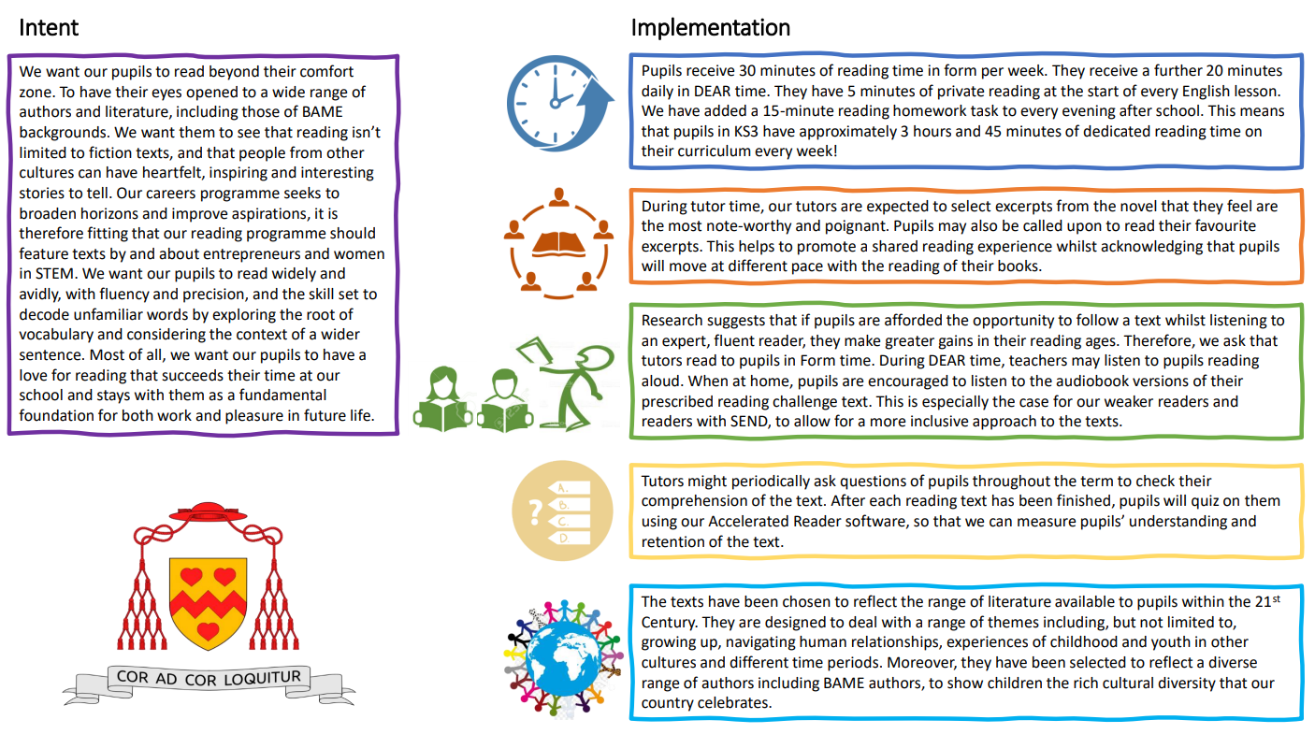

Slide 3
Year 7
Text | Author | Pages | Curriculum Links
You Are Awesome | Matthew | 152 | Ourselves, PSHE
The Soup Movement | Ben Davis | 313 | Friendship, Homelessness. Includes discussion of homelessness, unethical businesses and childhood cancer which, though tactfully handled, may be upsetting for some readers
The Boy Who Made Everyone Laugh | Helen Rutter | 295 | Humorous stories, Bullying, Disabilities, Neurodiversity
The Final Year | Matt Goodfellow | 288 | Families, School stories, Bullying, Mental Health, Self-esteem / self-acceptance, Novels in verse

Slide 4
Year 8
Text | Author | Pages | Curriculum Links
When the World Was Ours | Liz Kessler | 300 | World War Two, Historical stories, Holocaust, Award winners
Just Another Little Lie | Eve Ainsworth | 104 | Families, Alcohol abuse, Dyslexia-friendly
The Island at the End of Everything | Kiran Millwood Hargrave | 244 | Award winners, Parent, and child, Black, Asian or minority ethnic author/illust, Islands, Diseases, Friendship
After The War: from Auschwitz to Ambleside | Tom Palmer | 208 | World War Two, Jews, Refugees, Dyslexia-friendly

Slide 5
Year 9
Text | Author | Pages | Curriculum Links
Bad Influence | Tasmin Winter | 374 | School stories, Internet, Friendship, Bullying
Needle | Patrice Lawrence | 128 | Families, Dyslexia-friendly, Black, Asian or minority ethnic author/illustrator, Fostering, Black, Asian or minority ethnic characters, Award winners
Steady for This | Nathanael Lessore | 256 | Adolescence, Music, Relationships, Debut author/illustrator, Black, Asian or minority ethnic author/illustrator, Humorous stories
The Outsiders | S E Hinton | 136 | United States of America, Violence, Bullying

Slide 6
Year 10
Text | Author | Pages | Curriculum Links
Unboxed | Non Pratt | 112 | LGBTQ, Death, Friendship, Letters, Dyslexia-friendly
Vile Stars | Sera Milano | 373 | Relationships
Happy Head | Josh Silver | 400 | Adventure stories, Science fiction, Mental Health, LGBTQ, Romance
The Bunker Diary | Kevin Brooks | 259 | Mystery stories, Death, Award winners, Crime stories, Friendship, Thrillers

Slide 7
Year 12
(optional for Year 13)
Text | Author | Pages | Curriculum Links
You Could Be So Pretty | Holly Bourne | 395 | Dystopia, Gender roles, LGBTQ, Mental Health, School stories
Gone Girl | Gillian Flynn | 463 | Thrillers, Fiction, Crime stories
Kiss the Girls | James Patterson | 512 | Fiction, Detective stories, Crime stories, Thrillers
Different Seasons | Stephen King | 688 | Fiction, Horror stories, Thrillers

